Slide 1
Perseverance of the Saints
Eternal Security
Once saved always saved????
Once I’ve made a commitment to Jesus, am I saved forever?
Am I on a road I cannot get off of? (even if I want to); or
Is it possible to lose my salvation?
Taking the Bible as it’s simply written, it seems to indicate that if a Christian doesn’t persevere in their faith, they can lose their salvation...
And yet a lot of churches and a lot of Christians, very strongly disagree with this...
Sometimes a tradition or a “theology” colours how we choose to interpret the Scriptures
  A person’s theology (understanding of God) shapes how they interpret the Bible
  Whereas the Bible should be shaping our theology (our understanding of God)
John Calvin (a well known reformer) concentrated his theology very strongly, on the doctrine of “predestination” (God pre-destines us – God chooses to call us and save us)
[ Being saved, is taken completely out of human hands (no free will) ]
Calvinism developed the 5 points of calvinism

Slide 2
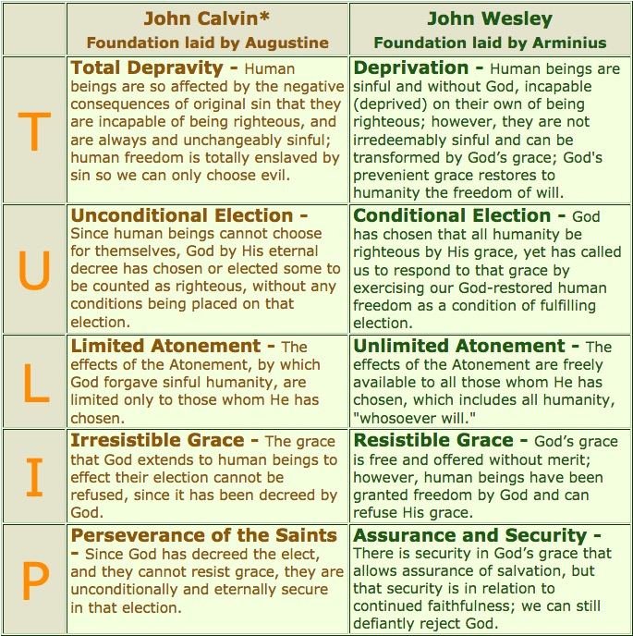
A person’s theology (understanding of God) may shape how they interpret the Bible
Whereas the Bible should be shaping our theology (our understanding of God)

Slide 3
Taking the Bible as it’s simply written, it seems to indicate that if a Christian doesn’t persevere in their faith, they can lose their salvation...
And yet a lot of churches and a lot of Christians, very strongly disagree with this...
Sometimes a tradition or a “theology” colours how we choose to interpret the Scriptures
  A person’s theology (understanding of God) shapes how they interpret the Bible
  Whereas the Bible should be shaping our theology (our understanding of God)
Predestination means that God prepares for our destiny (ahead of time)
Our destiny is to be saved – a process that is not complete, until Christ returns in Glory
(We are being saved)
^{1 Corinthians 15:1} Now I would remind you, brothers, of the gospel I preached to you, which you received, in which you stand, ² and by which you are being saved, if you hold fast to the word I preached to you—unless you believed in vain.

Slide 4
^{Romans 8:28} And we know that for those who love God all things work together for good, for those who are called according to his purpose. ²⁹ For those whom he foreknew he also predestined to be conformed to the image of his Son, in order that he might be the firstborn among many brothers. ³⁰ And those whom he predestined he also called, and those whom he called he also justified, and those whom he justified he also glorified.
³¹ What then shall we say to these things? If God is for us, who can be against us? ³² He who did not spare his own Son but gave him up for us all, how will he not also with him graciously give us all things? ³³ Who shall bring any charge against God’s elect? It is God who justifies.

Slide 5
³⁴ Who is to condemn? Christ Jesus is the one who died—more than that, who was raised—who is at the right hand of God, who indeed is interceding for us. ³⁵ Who shall separate us from the love of Christ? Shall tribulation, or distress, or persecution, or famine, or nakedness, or danger, or sword? ³⁶ As it is written,
“For your sake we are being killed all the day long;
we are regarded as sheep to be slaughtered.”
³⁷ No, in all these things we are more than conquerors through him who loved us. ³⁸ For I am sure that neither death nor life, nor angels nor rulers, nor things present nor things to come, nor powers, ³⁹ nor height nor depth, nor anything else in all creation, will be able to separate us from the love of God in Christ Jesus our Lord.

Slide 6
Taking the Bible as it’s simply written, it seems to indicate that if a Christian doesn’t persevere in their faith, they can lose their salvation...
And yet a lot of churches and a lot of Christians, very strongly disagree with this...
Sometimes a tradition or a “theology” colours how we choose to interpret the Scriptures
  A person’s theology (understanding of God) shapes how they interpret the Bible
  Whereas the Bible should be shaping our theology (our understanding of God)
Predestination means that God prepares for our destiny (ahead of time)
Our destiny is to be saved – a process that is not complete, until Christ returns in Glory
(We are being saved)
Romans 8 – an assurance of salvation to those who love God and are standing strong in their faith in the midst of persecution
^{Romans 11:21} For if God did not spare the natural branches (Israel), neither will he spare you. (gentile Christians) ²² Note then the kindness and the severity of God: severity toward those who have fallen (unbelieving Jews), but God’s kindness to you (Christians), provided you continue in his kindness. Otherwise you too (Christians who don’t persevere) will be cut off.

Slide 7
Taking the Bible as it’s simply written, it seems to indicate that if a Christian doesn’t persevere in their faith, they can lose their salvation...
And yet a lot of churches and a lot of Christians, very strongly disagree with this...
Sometimes a tradition or a “theology” colours how we choose to interpret the Scriptures
  A person’s theology (understanding of God) shapes how they interpret the Bible
  Whereas the Bible should be shaping our theology (our understanding of God)
Predestination means that God prepares for our destiny (ahead of time)
Our destiny is to be saved – a process that is not complete, until Christ returns in Glory
(We are being saved)
Romans 8 – an assurance of salvation to those who love God and are standing strong in their faith in the midst of persecution
Romans 11 – If you don’t continue, you will be cut off.
^{John 15:5} I am the vine; you are the branches. Whoever abides in me and I in him, he it is that bears much fruit, for apart from me you can do nothing. ⁶ If anyone does not abide in me he is thrown away like a branch and withers; and the branches are gathered, thrown into the fire, and burned.

Slide 8
Taking the Bible as it’s simply written, it seems to indicate that if a Christian doesn’t persevere in their faith, they can lose their salvation...
And yet a lot of churches and a lot of Christians, very strongly disagree with this...
Sometimes a tradition or a “theology” colours how we choose to interpret the Scriptures
  A person’s theology (understanding of God) shapes how they interpret the Bible
  Whereas the Bible should be shaping our theology (our understanding of God)
Predestination means that God prepares for our destiny (ahead of time)
Our destiny is to be saved – a process that is not complete, until Christ returns in Glory
(We are being saved)
Romans 8 – an assurance of salvation to those who love God and are standing strong in their faith in the midst of persecution
Romans 11 – If you don’t continue, you will be cut off.
John 15:6 – If one does not abide in Jesus – thrown away; thrown in fire; burned
^{John 3:16} “For God so loved the world, that he gave his only Son, that whoever believes (present tense – “is believing”) in him should not perish but have eternal life.

Slide 9
Taking the Bible as it’s simply written, it seems to indicate that if a Christian doesn’t persevere in their faith, they can lose their salvation...
And yet a lot of churches and a lot of Christians, very strongly disagree with this...
Sometimes a tradition or a “theology” colours how we choose to interpret the Scriptures
  A person’s theology (understanding of God) shapes how they interpret the Bible
  Whereas the Bible should be shaping our theology (our understanding of God)
Predestination means that God prepares for our destiny (ahead of time)
Our destiny is to be saved – a process that is not complete, until Christ returns in Glory
(We are being saved)
Romans 8 – an assurance of salvation to those who love God and are standing strong in their faith in the midst of persecution
Romans 11 – If you don’t continue, you will be cut off.
John 15:6 – If one does not abide in Jesus – thrown away; thrown in fire; burned
^{1 Corinthians 9:26} So I do not run aimlessly; I do not box as one beating the air. ²⁷ But I discipline my body and keep it under control, lest after preaching to others I myself should be disqualified.

Slide 10
Taking the Bible as it’s simply written, it seems to indicate that if a Christian doesn’t persevere in their faith, they can lose their salvation...
And yet a lot of churches and a lot of Christians, very strongly disagree with this...
Sometimes a tradition or a “theology” colours how we choose to interpret the Scriptures
  A person’s theology (understanding of God) shapes how they interpret the Bible
  Whereas the Bible should be shaping our theology (our understanding of God)
Predestination means that God prepares for our destiny (ahead of time)
Our destiny is to be saved – a process that is not complete, until Christ returns in Glory
(We are being saved)
Romans 8 – an assurance of salvation to those who love God and are standing strong in their faith in the midst of persecution
Romans 11 – If you don’t continue, you will be cut off.
John 15:6 – If one does not abide in Jesus – thrown away; thrown in fire; burned
^{Colossians 1:22} he has now reconciled in his body of flesh by his death, in order to present you holy and blameless and above reproach before him, ²³ if indeed you continue in the faith, stable and steadfast, not shifting from the hope of the gospel that you heard, which has been proclaimed in all creation under heaven, and of which I, Paul, became a minister.

Slide 11
Taking the Bible as it’s simply written, it seems to indicate that if a Christian doesn’t persevere in their faith, they can lose their salvation...
And yet a lot of churches and a lot of Christians, very strongly disagree with this...
Sometimes a tradition or a “theology” colours how we choose to interpret the Scriptures
  A person’s theology (understanding of God) shapes how they interpret the Bible
  Whereas the Bible should be shaping our theology (our understanding of God)
Predestination means that God prepares for our destiny (ahead of time)
Our destiny is to be saved – a process that is not complete, until Christ returns in Glory
(We are being saved)
Romans 8 – an assurance of salvation to those who love God and are standing strong in their faith in the midst of persecution
Romans 11 – If you don’t continue, you will be cut off.
John 15:6 – If one does not abide in Jesus – thrown away; thrown in fire; burned
A different explanation used to try and fit Once Saved Always Saved theology
  “The bible isn’t warning us about losing salvation – it’s warning us about the possibility of losing our reward”
  “The bible is talking about people who were never saved in the first place”

Slide 12
^{James 5:19} My brothers, if anyone among you wanders from the truth and someone brings him back, ²⁰ let him know that whoever brings back a sinner from his wandering will save his soul from death and will cover a multitude of sins.
^{2 Peter 2:20} If they have escaped the corruption of the world by knowing our Lord and Saviour Jesus Christ and are again entangled in it and overcome, they are worse off at the end than they were at the beginning. ²¹ It would have been better for them not to have known the way of righteousness, than to have known it and then to turn their backs on the sacred command that was passed on to them.

Slide 13
Taking the Bible as it’s simply written, it seems to indicate that if a Christian doesn’t persevere in their faith, they can lose their salvation...
And yet a lot of churches and a lot of Christians, very strongly disagree with this...
Sometimes a tradition or a “theology” colours how we choose to interpret the Scriptures
  A person’s theology (understanding of God) shapes how they interpret the Bible
  Whereas the Bible should be shaping our theology (our understanding of God)
Predestination means that God prepares for our destiny (ahead of time)
Our destiny is to be saved – a process not completed, until Christ returns. We are being saved
Romans 8 – an assurance of salvation to those who love God and are standing strong in their faith in the midst of persecution
Romans 11 – If you don’t continue, you will be cut off.
John 15:6 – If one does not abide in Jesus – thrown away; thrown in fire; burned
A different explanation used to try and fit Once Saved Always Saved theology
  “Not about losing salvation – it’s warning us about the possibility of losing our reward”
  “The bible is talking about people who were never saved in the first place”
These attempts don’t stack up (see James 5:19-20 & 2 Peter 2:20-21)
If a Christian who doesn’t persevere in their faith can lose salvation:
Endure. Keep on in the faith. Keep loving God and living as a disciple of Jesus Christ
Encourage our brothers and sisters in Christ, to persevere. Encourage those who fall away.

